Slide 1
E-Supervision the challenges
Eileen McKee, Assistant Dean, Field Education
Factor-Inwentash Faculty of Social Work
University of Toronto, Canada
Transforming the Field Education Landscape:
Virtual Field Summit
July 13-16, 2020

Slide 2
SHARE YOUR EXPERIENCE
In chat room (two minutes):
What methods or models of E-supervision for social work students exist or warrant further exploration?
What are the potential benefits and challenges of e-supervision in social work field education?

Slide 3
CASWE e-supervision module (May 2020)
Definitions
Teleconferencing
Emailing
Texting
Videoconferencing
Guidelines and Best Practices; Benefits and Challenges
Privacy
Resources
Notes:
*Possibly done in breakout rooms (depending on number of participants)

Slide 4
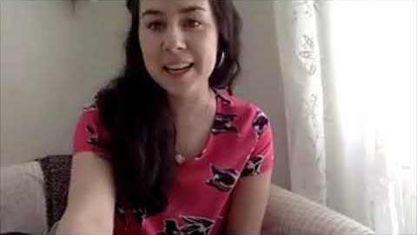
MSW E-supervision: A student and her field instructor share their experience

Slide 5
SHARE YOUR EXPERIENCE
What methods or models of E-supervision for social work students exist or warrant further exploration?
What are the potential benefits and challenges of e-supervision in social work field education?
List outcomes of this discussion for you after this conference.

