Slide 1
Virtual Field Summit Transforming the Field Education Landscape (TFEL) the challenges
Breakout Session: Indigenous and Anticolonial Practice
Dr. Natalie Clark and Lisa Armstrong, MSW
The Transforming the Field Education Landscape (TFEL) project is supported in part by the Social Sciences and Humanities Research Council of Canada.
Partnership Grant: Talent (2019-2024)

Slide 2
Acknowledgments
Acknowledge the Secwepemc Nation and Indigenous lands where each of you join this from – I also acknowledge the Elders, knowledge keepers
My coming to know, slexlexs, my readings and learning on the land has been in Secwepemculecw. This work is grounded in my own intersecting kinship relationships to Indigenous communities and the systems in which our lives are shaped. I know to whom I am accountable, and I know to whom I belong. These relationships define my responsibility and my role within the Secwepemc nation.
Give thanks to the organizers for inviting us to share with you and to all of you for making time today to be part of the circle
Art designed
by Secwepemc artist
Tania Willard.
Notes:
my work is informed and mobilized through my interconnected identities as a solo-parent of three Indigenous (Secwepemc) children; an activist and scholar and violence counsellor, and my metis ancestry. My violence work and activism is enriched and informed by my years of experience as a child/youth sexual abuse counsellor, addictions counsellor, and girls group facilitator, particularly within urban and rural Indigenous communities.

Slide 3
Activity: grounding in here & now
Take a moment right now and find an item that makes you feel good from a sensory place (a smell, a taste, something to hold/touch, a visual)
After this talk I invite you to take a wellness walk find sensory items that makes you feel good and could be part of your wellness bundle (smell, touch, taste, visual)

Slide 4
setting the circle – relational knowing
Please say your name, where you are located, and identify 1 gift or strength you bring to this work already and 1 hope or questions you have for this workshop

Slide 5
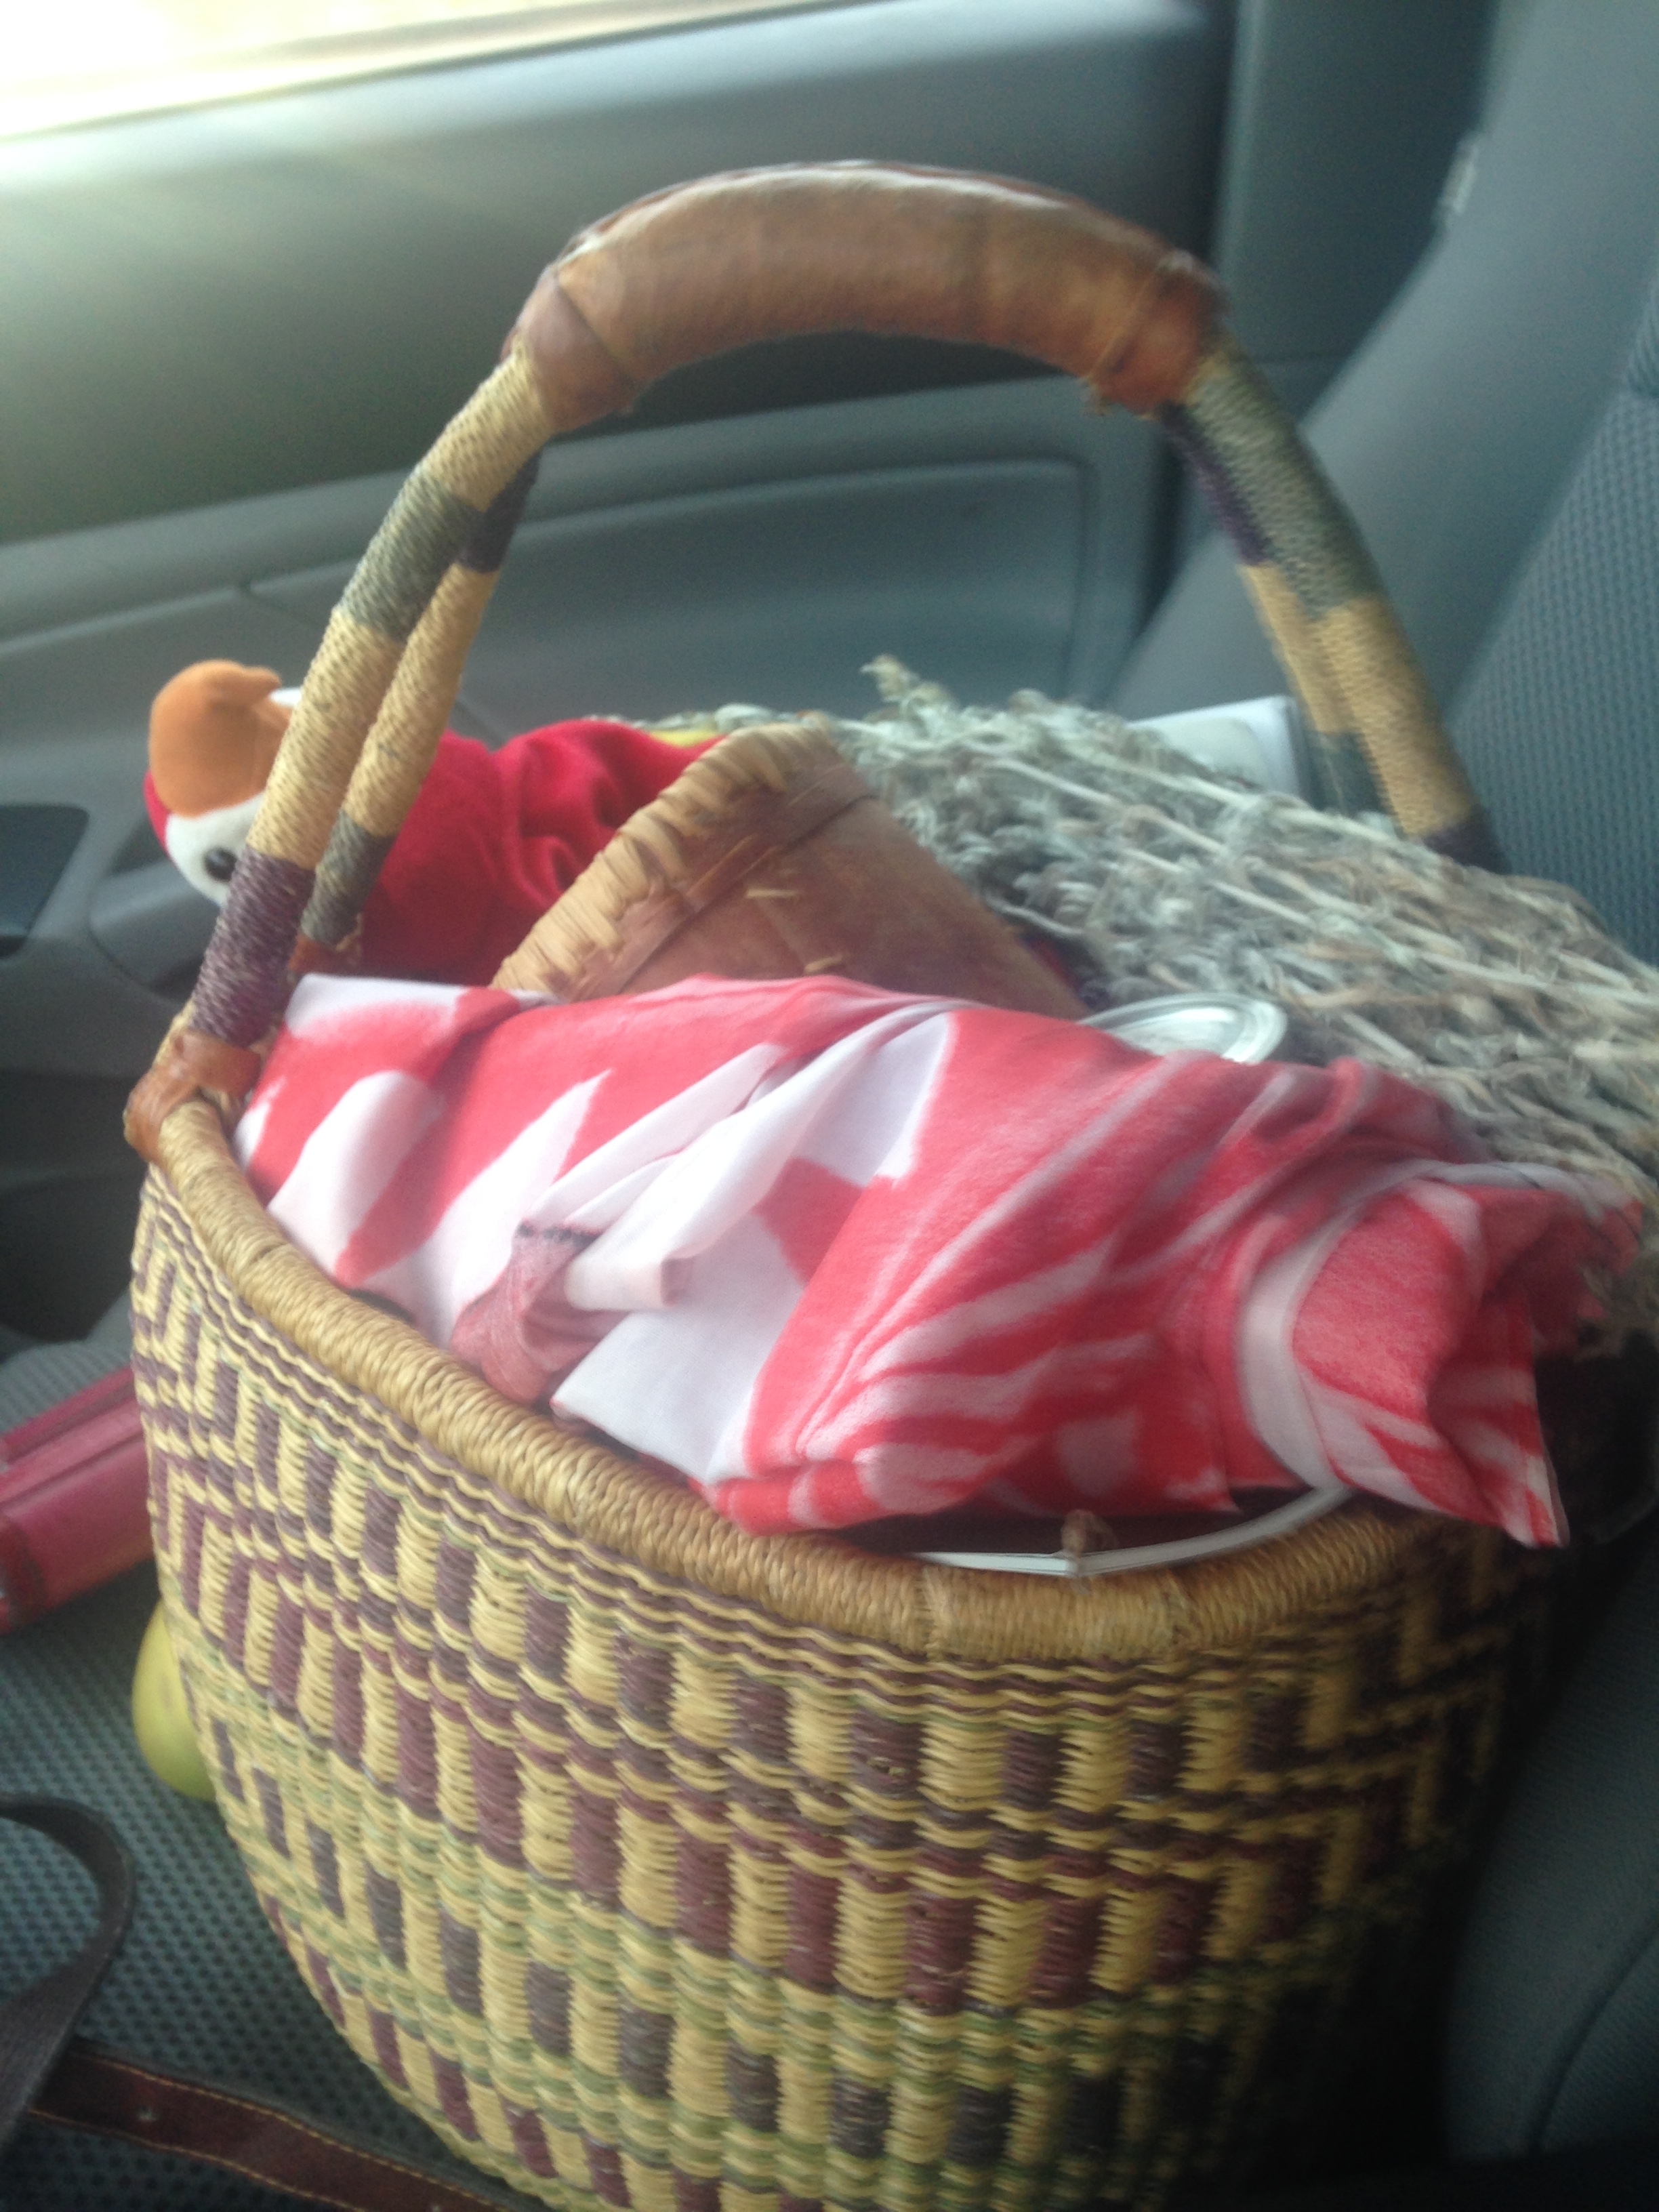
What is in your basket?

Slide 6
Towards Indigenous Wise Practices
"In what ways can Indigenous and anti-colonial field practica and research opportunities become more available to students?”
Please provide examples from your own experience of wise or promising practices with respect to Indigenous field and research

Slide 7
Contact: nclark@tru.ca
Walking I am listening to a deeper way. Suddenly all my ancestors are behind me. Be still, they say. Watch and listen. You are the result of the love of thousands.
Linda Hogan

Slide 8
For more information
about the partnership please contact:
tfelproject@gmail.com
Dr. Julie Drolet
Project Director
jdrolet@ucalgary.ca

