Slide 1
Virtual Field Summit Transforming the Field Education Landscape (TFEL) the challenges
Faculty of Social Work
Central and Northern Alberta Region (CNAR)
University of Calgary
July 14, 2020
Edmonton, Alberta

Slide 2
Acknowledgement
The Transforming the Field Education Landscape (TFEL) project is supported in part by the Social Sciences and Humanities Research Council of Canada.
Partnership Grant: Talent (2019-2024)
Amount: $1,980,640 (CAD)

Slide 3
Territorial Acknowledgement
The University of Calgary respectfully acknowledges that we are located on Treaty 6 territory, a traditional gathering place for diverse Indigenous peoples including the Cree, Blackfoot, Metis, Nakota Sioux, Iroquois, Dene, Ojibway/Saulteaux/ Anishinaabe, Inuit, and many others whose histories, languages, and cultures continue to influence our vibrant community.
L’Université de Calgary reconnaît respectueusement qu’elle est située sur les terres du Traité 6, lieu de rassemblement traditionnel pour de nombreux peuples autochtones dont les Cris, les Pieds-Noirs, les Métis, les Sioux des Nakotas, les Iroquois, les Dénés, les Ojibwés/Saulteaux/Anichinabés, les Inuits et bien d’autres encore, dont les histoires, les langues et les cultures continuent d’influencer notre communauté si vivante.
ii’ taa’poh’to’p
University of Calgary Office of Indigenous Engagement

Slide 4
Agenda
JUNE 14, 2020
8:45 am – 9:00 am Connect to Zoom
9:05 am – 9:10 am Welcome – Dr. Ellen Perrault, Dean, Faculty of Social Work, University of Calgary
9:10 am – 9:15 am TFEL Update – Dr. Julie Drolet, Project Director
9:15 am – 9:45 am “The State of Social Work Field Education” Plenary Session
9:45 am – 10:00 am Break
10:00 am – 11:00 am “The Context of Social Work Field Education” Panel Presentation
11:10 am – 11:15 am Break
11:15 am – 12:15 am Breakout Discussions

Slide 5
Connect with us virtually
Connect with us by joining the Virtual Field Summit conversation online using the hashtags:
#FieldSummit2020
#TFELproject
Participants of the Virtual Field Summit can use the hashtag to connect by sharing their thoughts, experiences, and content.
Notes:
Narration: The TFEL Project is active on social media platforms, including Facebook and Twitter, and we encourages participants of the Virtual Field Summit to share their thoughts and experiences using the conference hashtags #FieldSummit2020 and #TFELproject. Using these hashtags is also a great way to network and keep the conversations going even after the conference has ended. Throughout the conference we will be re-tweeting on the TFELProject twitter feed. Thanks in advance for your participation!

Slide 6
TFEL Goal
The goal of this project is to integrate research and practice in the preparation of the next generation of social workers by developing partnered research training initiatives, both within academic and across the public and not-for-profit sectors, that enhance student research practice knowledge and applied skill development.

Slide 7
Our Team Co-Investigators (13)
Uzoamaka Anucha (York University)
Marion Bogo (University of Toronto)
Grant Charles (University of British Columbia)
Natalie Clark (Thompson Rivers University)
Jill Hanley (McGill University)
Sheri McConnell (Memorial University of Newfoundland)
Eileen McKee (University of Toronto)
David Nicholas (University of Calgary)
Michelle Reid (Nicola Valley Institute of Technology)
Sally St. George (University of Calgary)
Tamara Sussman (McGill University)
Christine Walsh (University of Calgary)
Daniel Wulff (University of Calgary)

Slide 8
Collaborators (51)
Yumna Al-Ademi (Wilfrid Laurier University)
Wayne Ambrose-Miller (University of Windsor)
Cheryl Aro (University of Victoria)
Rochelle (Robbie) Babines-Wagner (University of Calgary)
Carrie Blaug (University of Calgary)
Roxanne Caron (Universite de Montreal)
Janice Chaplin (McMaster University)
Timothy Dueck (Nicola Valley Institute of Technology)
Jennifer Dunlop (Wilfrid Laurier University)
Kara Fletcher (University of Regina)
Nancy Freymond (Wilfrid Laurier University)
Amy Fulton (University of Calgary)
Gaisson, Florette (Universite de Saint-Boniface)
Jenna Garlick (Lakehead University)
Alexie Glover (University of Victoria)
Cyndi Hall (Dalhousie University)
Sophie Hanley (Universite de Moncton)
Tuula Heinonen (University of Manitoba)
Leanne Hilsen (University of Calgary)
Nicole Ives (McGill University)
Angela Judge-Stasiak (University of Calgary)
Lucki Kang (University of Fraser Valley)
Ursula Katic (Nicola Valley Institute of Technology)
Regine King (University of Calgary)
Lorraine Letkemann (University of Calgary)
Liza Lorenzetti (University of Calgary)
Sue-Ann MacDonald (Universite de Montreal)
Danielle Maltais (Universite du Quebec a Chicoutimi)
Julie Mann-Johnson (University of Calgary)
Woo Jin Edward Lee (Universite de Montreal)
Indrani Margoiln (University of Northern BC)
Anne-Marie McLaughlin (University of Calgary)
Brenda Morris (Carleton University)
Pam Orzeck (McGill University)
Andre-Anne Parent (Universite de Montreal)
Tammy Pearson (University of Northern BC)
Sheila Sammon (McMaster University)
Patricia Samson (University of Calgary)
Rebecca Sanford (Thompson Rivers University)
Jeanette Schmid Robertson (Langara College)
Jeanette Schmid (Vancouver Island University)
Jacqueline Shortridge (University of Manitoba)
David Sullivan (University of Manitoba)
Dora Tam (University of Calgary)
Sherri Tanchak (University of Calgary)
Nico Trocme (McGill University)

Slide 9
PartnerS (39)
Alberta Association of Immigrant Servicing Agencies
Alberta College of Social Workers
Alberta Health Services
ASSIST Community Services Centre
Autism Research Centre, Glenrose Rehabilitation Hospital
Babcock University
British Columbia Association of Social Workers
Calgary Counselling Centre
Canadian Association for Social Work Education - Association canadienne pour la formation en travail
Canadian Association of Social Workers
City of Calgary, Calgary Emergency Management Agency
City University of Hong Kong
Community Social Work Team - Health and Wellness Services, University of Alberta
Council on Social Work Education
Department of Applied Philosophy, Chang Jung Christian University
Department of Social Work, Madras Christian College
Edmonton Mennonite Centre for Newcomers
Glenrose Rehabilitation Hospital
Habitus Consulting Collective
Integrated Health and Social Services University
Network for West-Central Montreal
International Association of Schools of Social Work (IASSW)
McGill University, School of Social Work
Mitacs
Nicola Valley Institute of Technology
Newfoundland & Labrador Association of Social Workers
Ontario Association of Social Workers
Ordre des travailleurs sociaux et des thérapeutes conjugaux et familia
Royal Alexandra Hospital
School of Social Work, College of Social Sciences, Addis Aba University
Simmons School of Social Work
SYSU Centre for Social Work Education and Research
The University of British Columbia, School of Social Work
Thompson Rivers University
University of Eswatini
University of Gondar
University of South Florida
University of Stirling
Youth Research & Evaluation eXchange (YouthREX)

Slide 10
Training and Mentoring activities
Stream 1
Digital Storytelling
Stream 2
National Study
Stream 3
Applied Practice Research

Slide 11
Current Activities
Interviews on Promising and Wise Practices
Recruiting field directors/coordinators, faculty, field instructors, and other field stakeholders for a 30-60 min. interview
Impact of COVID-19 on Field Education
Recruiting BSW and MSW social work students to complete an online survey
Dialogue Circles
Recruiting BSW, MSW, and PhD social work students
State of Social Work Field Education
Analyzing data from the National survey with field directors/coordinators across Canada
Virtual Practicum Resources
Supporting BSW and MSW practicum students with opportunities to develop resources
Digital Story Guidebook
Developing a resource to support digital storytelling in field seminars
Field Image Showcase
Inviting BSW, MSW, and PhD students to submit an image and a narrative
Applied Practice Research Module
Developing an online training module to facilitate practice research in field education
Near-peer Model for Mentorship
Creating and integrating mentorship into social work education
Contact tfelresearch@gmail.com to participate!
Contact tfelproject@gmail.com to join!

Slide 12
‘field research scholars’ program
Launch of the “Field Research Scholars” Program for Fall 2020
This program is designed to foster talent in emerging social workers and transform them into highly qualified personnel by providing mentorship, professional development opportunities and opportunities for collaboration with peers. By fostering research skills and engaging social workers from various specialties, emerging social workers will have the opportunity to join a network of scholars working towards transforming the field education landscape.
The objectives of this program include:
Fostering a network of reciprocal mentorship relationships and peer collaboration;
Transforming social work graduates into highly qualified personnel who contribute to field education research and education; and
Creating professional development opportunities for emerging social work researchers including workshops, seminars and working groups to enhance research skills in the area of field education.
Applications are requested from both students and mentors who are interested
Deadline to apply for the Fall 2020 program is August 31st, 2020

Slide 13
PLENARY SESSION

Slide 14
State of social work field education national survey: Preliminary findings
Presented by:
Dr. Julie Drolet, PhD, RSW
Mohammad Idris Alemi
Cara Au
Elisa Poon
Ory Li Pi Shan
Jayden Wickman
TFEL Virtual Field Summit
July 14th, 2020
Notes:
Julie

Slide 15
overview
Introduction
Context
Literature Review
National Survey
Methodology
Preliminary Findings
Survey Feedback
Questions
Notes:
Julie

Slide 16
Introduction
Dr. Julie Drolet PhD, RSW
Julie is Professor in the Faculty of Social Work at the University of Calgary and Project Director of the TFEL partnership.
Mohammad (MSW), Cara (BSW), Elisa (BSW), Ory (MSW) and Jayden (BSW) are members of the State of Social Work Field Education National Survey team.
They are research assistants with the TFEL project and are social work students from the University of Calgary.
Notes:
Julie

Slide 17
Context
The Council on Social Work Education (CSWE) developed the 2015 State of Field Education Survey on administrative models, staffing and resources of field education programs in the USA (CSWE, 2015).
The TFEL project developed a national survey on the state of field education in Canada based on the CSWE 2015 survey.
We hope the survey findings will increase awareness of the critical state of field education and support a concerted effort to develop more sustainable models of field education.
Retrieved from: https://online.une.edu/blog/cswe-accreditation/
Notes:
Ory: To give some context...
The CSWE Council on Field Education developed the 2015 State of Field Education Survey to understand the variations in administrative models, staffing and resources of social work field education programs across the United States (CSWE, 2015).
The TFEL project aimed to expand understanding of the state of field education in Canada and developed a national survey that utilized the CSWE's 2015 State of Field Education Survey as a guide and tailored it to fit the Canadian context (Drolet, 2020).
We hope the survey findings will increase understanding and awareness of the variation in staffing, administration and resource allocations in field education across Canada. And support a concerted effort to develop more sustainable models of field education.

Slide 18
Literature Review
Field education coordinators and programs experience:
A lack of resources and support (Council on Social Work Education, 2015; Macdonald, 2003; Robertson, 2013)
Rising student demand for placement (Ayala et al., 2018b; Bogo, 2015)
Increasing workload (Macdonald, 2013; Robertson, 2013)
Challenges with field instructor recruitment and retention (Ayala et al., 2018a, Ayala et al., 2018b)
In the future: TFEL will host a Fall 2020 webinar to discuss the results of a scoping review on field education and best practices; hosted by Marion Bogo and Karen Sewell (University of Toronto)
Notes:
Jayden: Lack of resources and support: lack of tenure track and faculty positions = associated with less important than classroom learning and less resources; financial cutbacks from government and agencies, additional challenges
Rising demand: increased enrollment, shortage of practicums and FEC’s have limited capacity to provide supervision, this is a complex issue, thus lessening FEC morale (Ayala et al., 2018b)
Workload: expectations to teach and research, little room for advancement; they also engage in counselling, referring, advising and mentoring students; report an expectation to go above and beyond in assessing suitability for students in becoming professionals, but without the institutional support from their university in addressing these challenges (Robertson, 2013)
Retention: previous points all build up to difficulty with recruitment and retention, makes it challenging to accommodate for all students, FEC being asked to do a lot but not receiving support in return
In the future: fall 2020 webinar to discuss the results of a scoping review on field education and best practices; hosted by Marion Bogo and Karen Sewell (UofT)

Slide 19
National survey
Purpose: to examine and gain a better understanding of the state of social work field education in Canada.
Field directors/coordinators perception of the current state of social work field education
Demographics of field coordinators and programs
Administrative models of field education
Breakdown and adequacy of resources
Workload expectations of field coordinators
Field education areas examined:
Notes:
Julie
The purpose of the national survey was to examine the current state of social work field education and gain insight on the gaps, crises and challenges experienced by field directors/coordinators across institutions in Canada.
Some questions the survey posed:
What are the demographics of field coordinators, BSW, & MSW students?
What are current administrative models of field education?
What is the breakdown of resources and are they adequate?
What are the workload expectations of the field coordinator role?
How do field coordinators perceive the current state of social work field education?

Slide 20
methodology
An online survey was used to gather descriptive statistics on the state of social work field education
A survey link was emailed to field directors/coordinators in all 43 CASWE-accredited institutions
Survey included multiple choice, Likert Scale, and open-ended short answer questions
Offered in English and French (French version professionally translated and locally reviewed)
Data collected and analyzed through Survey Monkey and Excel
French responses translated using Google Translate
Notes:
Elisa
As previously mentioned, the online survey was utilized to gather descriptive stats on the stage of social work field education and gather findings from field directors and coordinator experiences.
After national survey was created, survey link was emailed to field directors and coordinators in all 43 CSWE-accredited institutions across Canada. The survey included questions that were multiple choice, Likert Scale, and open ended short answer. As well, participants were emailed consistent reminders to complete the survey.
The survey was offered in both English and French, with the French version being professionally translated
Data collected and analyzed through Survey Monkey and Excel.
French survey responses were translated through Google Translate

Slide 21
Preliminary findings
Survey responses:
39 field directors/coordinators responded to the survey (39/43 = 90.7% response rate)
31 (79.5%) complete and 8 (20.5%) incomplete responses
Preliminary data analysis was completed by identifying the responses for each individual question
Descriptive analysis completed for: field director/coordinator demographics, program details, and perspectives on field education
Retrieved from: https://www.netclipart.com/isee/hJoRRT_basic-techniques-every-primary-and-secondary-data/
Notes:
Cara
Survey Responses:
39 field coordinators responded to the survey, 90.7% response rate (we are very pleased with our response rate)
31 complete and 8 incomplete responses
Data analysis presented in the next few slides show descriptive analysis based on responses for individual questions. Some questions had more responses than others due to the nature of the incomplete responses (which were not excluded from the data analysis).

Slide 22
Field Director/coordinator Demographics
Figure 1. A graph showing the highest degree earned by field directors/coordinators.
Figure 2. A graph showing the percentage of responses based on the number of years as a FEC.
Notes:
Ory:
Figure 1. Depicts the highest degree achieved by field education coordinators/directors. A majority have a MSW degree.
Figure 2. Shows the range in terms of years of experience as a field education director/coordinator. (Average number of years spent as a FEC was 6.6 years)

Slide 23
Field Director/coordinator Demographics
Figure 3. A chart representing the number of FTE based on employment status
Figure 4. A chart representing the number of FEC based on employment type
Notes:
Jayden
These two charts represent FEC employment
The left chart showcases FEC employment status, the majority of respondents reported having a permanent contract, while tenure track was significantly less, sessional, long term contract, and contracted annually only had 1 respondent each
The chart on the right represents FEC employment type, the majority of respondents reported being administrative staff and not having faculty designation, second was faculty designation with academic rank and the lowest faculty with clinical, practice or field designation

Slide 24
Field Director/coordinator Demographics
What would be adequate number of FTEs assigned to the field office for the “on site” programs(s)
 | BSW | MSW | Total
Mean | 2.9 | 1.8 | 2.5
Median | 2.0 | 1.5 | 2.0
Mode | 2.0 | 1.0 | 2.0
Range | 1.0-12.0 | 0.5-6.0 | 0.5-12.0
Table 1. A table representing perceptions of adequate staffing "FTEs" for "on site" programs at the BSW level, MSW level and total combined
Figure 5. A chart representing the number of FTE faculty assigned to "on-site" programs
Notes:
Jayden
The graph on the left represents how many Full time equivalent staff each institution currently has employed at their on site program assigned to any field education activities, these activities include administration, field advising, monitoring and supporting placements, and site visits.
Majority 3.5-4.4
The table on the right represents what would be an adequate number of FTEs assigned to the on site program that would result in timely and effective placements
It is evident that the BSW programs reported needing more FTEs, and also showcased the largest range, with one respondent reporting the need for 12 FTE for the on site field education program

Slide 25
Program details
Figure 6. A graph of the instructional language of Canadian BSW and MSW social work institution survey respondents
Figure 7. A graph of social work program(s) offered by institution
Notes:
Cara
10 of our respondents came from French speaking institutions and 29 from English.
Since 26% of all the 43 CASWE institutions offer programs in French, we are pleased with the representation of instructional languages in our survey sample.
Beside, we have a graph showing the number of institutions offering BSW programs only, MSW only, and both. As you can see, offering both degrees in one institution is by far the most common at 66.7%.

Slide 26
Program Details
We found that 97.4% of institutions include urban placements, 76.9% rural placements, 64.1% urban Indigenous placements, and 51.2% on reserve placements.
Figure 8. This graph presents the number of institutions supporting field placements based on the location of the placement
Notes:
Elisa
So now we’re going to talk about the program details.
This graph shows the different field placement settings per institution, and as you can see, it demonstrates that 97.4% of institutions include Urban locations, 76.9% include rural, 64.1% include Urban Indigenous, and 51.2% include placements on reserve. We were pleased to see that a little over half of institutions included placements on reserve, though Urban was clearly the most common placement setting.

Slide 27
University Demographics
 | Fewer than 100 | 100-249 | 250-499 | 500+
BSW Students | 11 | 9 | 6 | 2
MSW Students | 15 | 4 | 3 | 0
Combined | 7 | 9 | 8 | 5
Table 2. This table shows institutions by student size (number enrolled BSW, MSW and combined students)
 | Fewer than 100 | 100-249 | 250+
BSW Students | 13 | 11 | 5
MSW Students | 10 | 3 | 3
Combined | 9 | 13 | 9
Table 3. This table shares institutions by ranges of BSW, MSW and combined students in field placements
Notes:
Elisa
In terms of total numbers of students, there was a fairly even distribution of universities with numbers of students ranging from fewer than 100 to 250-499, and a couple with over 500. As expected when examining differences in BSW and MSW student numbers, there were more universities with student numbers of MSW students while more universities with greater numbers of BSW students.
And the second table shares the number of institutions with students in field placements. We wanted to highlight that or combined BSW and MSW students in field placements, the median number of institutions had a range of 100-249 students.

Slide 28
Online/distance or Blended programming
Of the institutions who responded “yes,” only 2 reported having separate and distinct field staff for online/distance or blended programs
Figure 9. A graph of online/distance or blended MSW and/or BSW program availability in institutions
Notes:
Cara
Only 43.8% of our respondents reported offering an online/distance or blended BSW and/or MSW program. Of these, only 2 reported having separate and distinct field staff to facilitate placements in these programs. We are curious to see if there will be more of this programming offered in the future, particularly during and after COVID-19.
Please note that the total respondents for this section is 32 due to incomplete responses.

Slide 29
Field Director/coordinator activities
Most Common Activities
Least Common Activities
Activity | Total Responses
Developing field manual | 32/32 (100.0%)
Relationship building with agencies | 32/32 (100.0%)
Participating in policy development | 31/32 (96.9%)
Advising students on field education-related matters | 31/32 (96.9%)
Participation in social work program committees | 30/32 (93.8%)
Activity | Total Responses
Teaching social work courses other than field education | 10/32 (31.3%)
Scholarly research, publications and presentations | 11/32 (34.4%)
Advising students on course selection, degree requirements and/or career planning | 11/32 (34.4%)
Administration of field education awards | 13/32 (40.6%)
Participation in student retention processes | 15/32 (46.9%)
Table 4. Most common reported activities for FEC/directors.
Table 5. Least common reported activities for FEC/directors.
Notes:
Omid
Disclaimer: This value is based on responses that answered this question
For this slide, we’ll discuss the findings we obtained that highlight the activities and responsibilities of FEC/directors. They survey asked respondents to report if they were responsible for completed a total of 41 activities.
The table on the left highlights the top 5 most common FEC/director activities/responsibilities and the table on the right highlights the 5 least common activities/responsibilities.
The majority of responses showed that field coordinators are responsible for developing a field manual, building relationships with agencies, participating in policy development, advising students on field education, and participating in program committees.
In comparison, less than half of the respondents reported that they were responsible for teaching social work courses (other than field education), scholarly research/publications, advising students on course selection/degree requirements, administration of field awards and supporting with student retention.
These two charts do not represent the range of responsibilities for FEC/directors but demonstrates the variation of roles based on the different social work programs.

Slide 30
Perspectives of field education – likert scale
Figure 10. A graph representing field director/coordinator perceptions about the state of social work field education based on responses from a 7-point likert scale (part 1).
Notes:
Omid
Next we will look at some of the responses from FEC/directors and their perceptions of the state of social work field education. Responses were recorded on a likert scale of strongly disagree to strongly agree. To better highlight the perceptions of FEC/directors, responses that stated strongly disagree/disagree (which is highlighted as red/pink on the chart) were combined and strongly agree/agree were combined (which is shown as light green/dark green). Responses that were stated as N/A are shown in orange.
The trend in the comments here show that FEC/directors experience challenges with student dynamics this includes things such as: field placements, pressures to increase student enrollment, etc.
Respondents generally agreed that they felt overwhelmed by the ongoing challenge of not having enough placements for students.
Lastly, we found an equal response between some FEC/directors feeling overwhelmed with the lack of adequate resources and staffing while other programs feel they have enough staff/resources to complete their roles as field education directors/coordinators at their institution.

Slide 31
Perspectives of field education – likert scale
Figure 11. A graph representing field director/coordinator perceptions about the state of social work field education based on responses from a 7-point likert scale (part 2).
Notes:
Omid
Continuing with the responses from the likert scale. This slide highlights the responses to statements that relate to field placement and the ability of FEC/directors to find new placements, challenges with agency staffing/funding, agencies volunteering to participate in field education and the overall challenge of meeting the range of expectations with the little amount of time to meet those expectations.
Overall, FEC/directors reported that they agreed with these challenges and the overwhelming disparities caused in field education due to the challenges of finding enough placements, meeting expectations and having agencies that can volunteer to support students.

Slide 32
Responses from the survey
“HELP!!!”
“We need admin support!”
“Staffing has not been sufficient to be able to complete all relevant tasks associated with field coordination. More resources are urgently needed.”
“Faculty in our institution do not have enough incentives to take up time-consuming field leadership roles.”
“Our programs lack administrative support staff for internships. The coordinators must therefore carry out administrative tasks, placement, teaching, continuing education. Lack of time to complete all expected tasks.”
Notes:
Cara
These are some of the additional responses provided by FEC and directors that completed the survey.
There was a general trend of requiring more support, having more resources to complete tasks and the lack of time to complete those tasks.
There were also notes about faculty not being provided enough incentives to take on tasks and FEC being responsible for a wide range of tasks.

Slide 33
Responses from the survey
“Our greatest challenge now is to plan for placements in the fall during the COVID-19 context.”
“I think field education should have its own budget and more say in who is hired to do field liaison work. I would like to see field coordinators be able to take something like a sabbatical which currently is not offered.”
“Resources for more field team staff are needed to develop new avenues/partnerships.”
“[Need] better standardization around the competencies of a BSW graduate and an MSW graduate, similar to other professions.”
“Being in a Faculty role I have the opportunity to be at Faculty table and on Directors Advisory Committee which means field is integrated throughout all decision making.”
Notes:
Omid
Continuing with some of the additional responses from they survey.
This slide covers some of the challenges FEC/directors experience with finding placements with the current pandemic/Covid-19 and the transition to virtual practicums/platforms.
Some responses highlight the lack of resources and funding for field but also the limited capacity for FEC/directors to create new avenues and partnerships with agencies which potentially creates new opportunities for students.
There were also responses that noted a need for new ways of standardizing competencies for BSW and MSW graduates and the importance of integrating field needs into decision making.

Slide 34
Conclusion
Preliminary findings support the current state of crisis in social work field education
Preliminary findings indicate the need for more sustainable models of field education
Next steps:
In-depth data analysis
Written report based on the findings
Submission of a journal article for publication
Comparative analysis of TFEL 2020 and CSWE 2015 survey findings
Retrieved from: https://www.pngitem.com/middle/iwmbRwR_software-clipart-r-d-hd-png-download/
Notes:
Julie
Our preliminary findings support the crisis state of social work field education and indicate a need for sustainable models of field education
Our next steps include an in-depth data analysis and writing a report on all of our findings. Additionally, we will look to publish two journal articles, one on specific findings in the study and a comparative article on TFEL 2020 and CSWE 2015 survey findings
Thank you very much for attending our presentation

Slide 35
references
Ayala, J., Drolet, J., Fulton, A., Hewson, J., Letkemann, L., Baynton, M., Elliott, G., Judge-Stasiak, A., Blaug, C., Gerard Tetreault, A. & Schweizer, E. (2018a). Restructuring social work field education in 21st Century Canada: From crisis management to sustainability. Canadian Social Work Review / Revue Canadienne De Service Social,35(2), 45-66.
Ayala, J., Drolet, J., Fulton, A., Hewson, J., Letkemann, L., Baynton, M., ... & Schweizer, E. (2018b). Field education in crisis: Experiences of field education coordinators in Canada. Social Work Education, 37(3), 281-293.
Bogo, M. (2015). Field education for clinical social work practice: Best practices and contemporary challenges. Clinical Social Work Journal, 43(3), 317-324.
Council on Social Work Education. (2015). State of Field Education Survey. https://www.cswe.org/CMSPages/GetFile.aspx?guid=05519d2d-7384-41fe-98b8-08a21682ed6e
Drolet, J. (2020). A new partnership: Transforming the field education landscape – Intersections of research and practice in Canadian Social Work Field Education. Field Educator, 10.1(Spring 2020). https://fieldeducator.simmons.edu/article/transforming-the-field-education-landscape/
Macdonald, L. (2013). Making the Invisible Visible: A Workload Study on the Role of Field Education Coordinators in Canada. Canadian Social Work, 15(1), 60-73.
Robertson, J. S. (2013). Addressing professional suitability in social work education. The Journal of Practice Teaching and Learning, 11(3), 98-117. https://doi.org/10.1921/2402110307

Slide 36
Questions?

Slide 37
For more information
about the project please email
tfelproject@gmail.com
Dr. Julie Drolet
Project Director
jdrolet@ucalgary.ca
Project Management Office

Slide 38
BREAK
9:45AM – 10:00AM MDT / 11:45AM – 12:00PM

Slide 39
Virtual field summit: panel PRESentation the challenges
Panelists:
Holly Bradley, MSW, RSW
Grant Charles, PhD, RSW
Clement Dlamini, MSW
Lena Dominelli, PhD, ACSS
Hosts:
Julie Drolet, PhD, RSW
Monika Pakstas, MSW Student
July 14, 2020

Slide 40
Acknowledgement
TFEL is supported in part by funding from the
Social Sciences and Humanities Research Council.

Slide 41
Welcome!
Outline for today’s session:
Housekeeping
Introductions
Panel questions
Concluding Q&A

Slide 42
Connect with us virtually
Connect with us by joining the Virtual Field Summit conversation online using the hashtags:
#FieldSummit2020
#TFELproject
Participants of the Virtual Field Summit can use the hashtag to connect by sharing their thoughts, experiences, and content.
Notes:
Narration: The TFEL Project is active on social media platforms, including Facebook and Twitter, and we encourages participants of the Virtual Field Summit to share their thoughts and experiences using the conference hashtags #FieldSummit2020 and #TFELproject. Using these hashtags is also a great way to network and keep the conversations going even after the conference has ended. Throughout the conference we will be re-tweeting on the TFELProject twitter feed. Thanks in advance for your participation!

Slide 43
Before we get started…
Today’s session will be approximately 60 minutes
Please ensure your microphone is muted if you are not speaking
Feel free to enter questions in the Q&A box. We will have 10-15 minutes for questions at the end.
There will be four panel questions, and we will have approximately 10 minutes for each question.

Slide 44
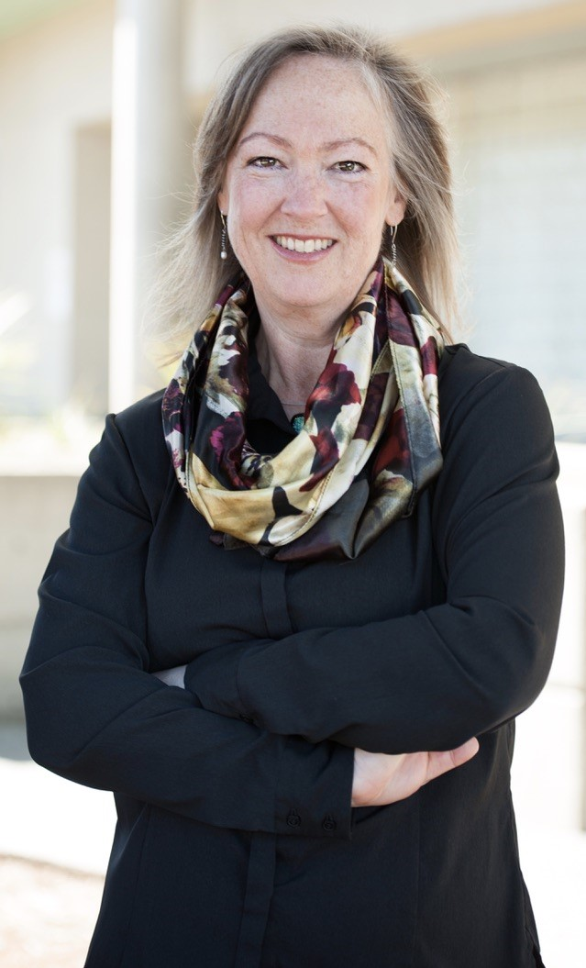
Holly bradley, msw, rsw
Holly Bradley is a grateful settler in the traditional and unceded territory of the Coast Salish Peoples and the traditional territory of the Snuneymuxw First Nation. She is the Field Education Coordinator for the online BSW program at Vancouver Island University where she has worked since 2009. Holly is in her fifth year as co-chair of the CASWE Field Education committee representing Social Work Field Coordinators and Directors across the country.

Slide 45
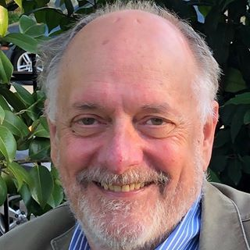
Grant charles, phd, rsw
Grant Charles is an Associate Professor in the School of Social Work and an affiliated faculty with the Division of Adolescent Health and Medicine in the Department of Pediatrics with the Faculty of Medicine at The University of British Columbia. He is a member of the UBC Cluster on Research Based Theatre and a member of the Prato International Collaborative on Family Mental Health. Dr. Charles has worked in a variety of child and youth mental health, special education, youth justice and child welfare settings.

Slide 46
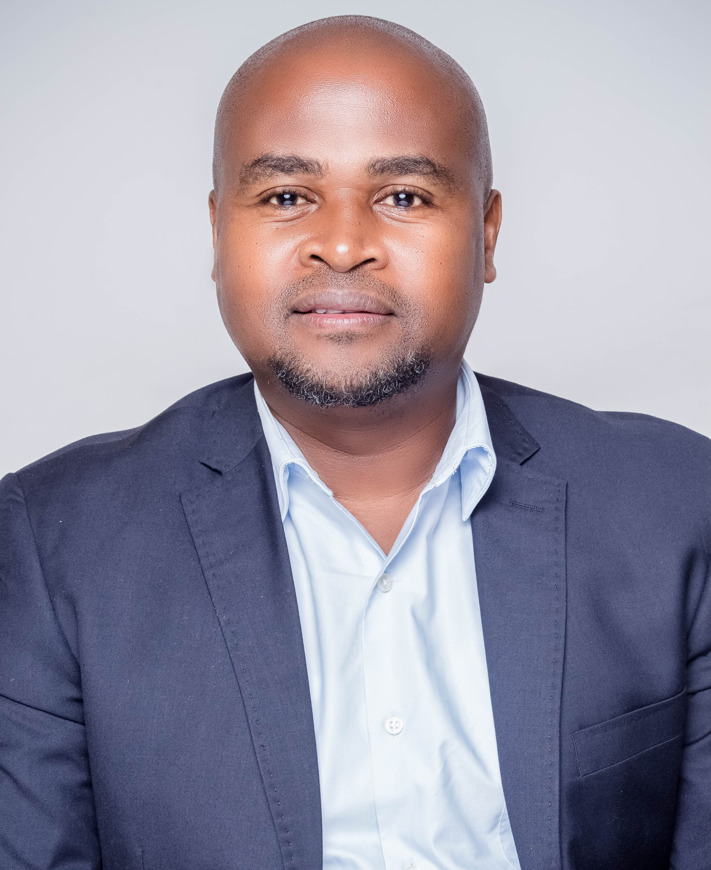
clement dLamini, msw
Clement Dlamini is the Director of Centre for Community Services and a Social Work Lecturer at the University of Eswatini in the Department of Sociology and Social Work. He is the Founding Member and current President of the Monitoring & Evaluation Association of Swaziland (MEAS). He has a Master's Degree in Social Work from the Stephen F. Austin State University School of Social Work in Nacogdoches, Texas. He has competencies in HIV and AIDS training, program design and evaluation, rural community development, community and health systems strengthening, community mobilization, policy analysis and participatory rural appraisal.

Slide 47
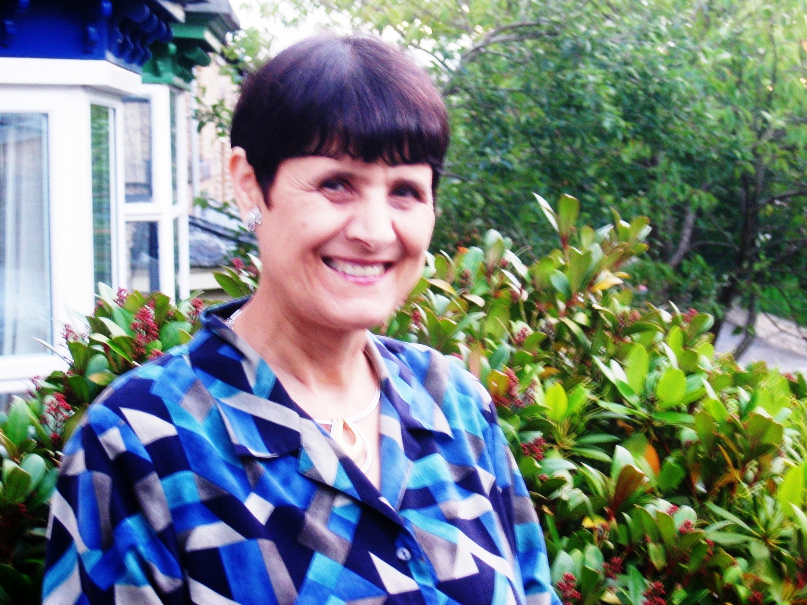
lena dominelli, phd, acss
Professor Lena Dominelli holds a Chair in Social Work at the University of Stirling in Scotland. She was previously Co-Director at the Institute of Hazards, Risk and Resilience (2010-2016) at Durham University. She has a specific interest in projects on climate change and extreme weather events including health pandemics like Covid-19, drought, floods, cold snaps; wildfires; earthquakes, volcanic eruptions; disaster interventions; vulnerability and resilience; community engagement; coproduction and participatory action research. Her research projects include funding from the ESRC, EPSRC, NERC, the Department of International Development and Wellcome Trust. Lena is a prolific writer and has published widely in social work, social policy and sociology. She currently chairs the IASSW Committee on Disaster Interventions, Climate Change and Sustainability and has represented the social work profession at the United Nations discussions on climate change, since Cancun, Mexico in 2010. She has received various honours for her work.

Slide 48
Question 1
What are the most pressing challenges facing social work field education?
How do you suggest they be addressed?
Quels sont les défis les plus pressants pour les stages en travail social?
Comment aborderiez-vous les défis rencontrés?

Slide 49
Question 2
How has social work field education responded and/or adapted to the COVID-19 pandemic?
What are some predictions on the effects of this on social work field education?
Do you believe this is a pivotal time for change in field education?
Comment les stages en travail social ont-ils répondu et / ou adapté à la pandémie de COVID-19?
Quelles sont les prévisions de ses effets sur les stages en travail social?
Croyez-vous que ce soit une période charnière pour le changement des stages?

Slide 50
Question 3
In what ways has the role of field education in social work changed over time?
What do you imagine the state of social work field education will look like in the future?
En quoi le rôle des stages dans le travail social a-t-il changé au fil du temps?
Comment imaginez-vous l'état des stages en travail social à l'avenir?

Slide 51
Question 4
With your experience, how do you see technology impacting the state of social work field education and the various populations that social workers work with?
D'après votre expérience, comment voyez-vous la technologie influencer l'état des stages en travail social et les différentes populations avec lesquelles les travailleurs sociaux travaillent?

Slide 52
Questions?

Slide 53
Closing remarks
Dr julie drolet
Monika pakstas

Slide 54
BREAK
11:00AM – 11:15AM MDT / 1:00PM – 1:15PM EDT
*Please connect to your Breakout Sessions at 11:15am MDT / 1:15pm EDT

