Slide 1
Virtual Field Summit Articulating Transformation in Field Education and Research Through Digital Storytelling the challenges
Christine A. Walsh, PhD, Professor
Natalie St-Denis, PhD(c)
Alison Grittner, PhD student
Faculty of Social Work, University of Calgary
July, 14, 2020

Slide 2
Acknowledgement
The Transforming the Field Education Landscape (TFEL) project is supported in part by the Social Sciences and Humanities Research Council of Canada.
Partnership Grant: Talent (2019-2024)
Amount: $1,980,640 (CAD)

Slide 3
Territorial Acknowledgement
We would like to acknowledge the traditional territories of the people of the Treaty 7 region in Southern Alberta, which includes the Blackfoot Confederacy (comprising the Siksika, Piikani, and Kainai First Nations), as well as the Tsuut’ina First Nation, and the Stoney Nakoda (including the Chiniki, Bearspaw, and Wesley First Nations). The City of Calgary is also home to Métis Nation of Alberta, Region III.
ii’ taa’poh’to’p
University of Calgary Office of Indigenous Engagement

Slide 4
Digital Storytelling
Digital storytelling (DST) is a creative process that provides opportunity for people to tell a story through the use of modern digital technologies (Burgess, 2006).
It blends creative writing, oral history, art therapy, and facilitative community media production techniques.
DST is a storytelling method that is interwoven with digitised images, texts, sounds and/or other digital elements, and it is frequently referred to as a practice method used in therapeutic or community settings (Chan & Yau, 2019; Sage et al., 2018).
It is used as a community development model, curriculum tool for elementary to graduate students, an aid to professional development and collaboration, and as a participatory research method (e.g., Notley & Tacchi, 2005; Skuse et al., 2007; University of Houston, n.d.; Vermont Teachers Teaching with Technology, n.d.).

Slide 5
DST In The Social Work Classroom
An Australian University’s social work teaching team developed a client-centered web-based DST case study as a form of practice simulation in an MSW program. They reposted that students mastered new skills, developed ways to self-manage and reflect on their emotional reactions to confronting and overwhelming situations without harming real clients. Challenges identified included not being able to interact with the simulated ‘client’ to ask further questions (Goldingay, Epstein, & Taylor, 2018).
In an MSW course on social justice, diversity and oppression sharing stories through DST was found to be transformative. IT created opportunity for reflection that helps “with students’ overall learning of concepts and ideas. . . think about oppression and diversity in an applied sense, to reflect on how oppression and diversity impacts their lives and the lives of their colleagues, and to challenge their own biases and perceptions of the various forms of societal oppression” ( Walsh et al., 2010, p. 11).
A BSW class used DST for students to co-create stories with seniors to deepen their understanding of the life course perspective.

Slide 6
DST IN Training Health Professionals
A 2018 systematic review by Moreau, Eady, Sikora, and Horsley on the use of DST in training health professionals characterized five different approaches: “(a) health professionals’ learning from creating their own digital stories, (b) health professionals’ learning from the perspectives of both the creators and viewers of the digital stories, (c) health professionals’ learning from listening to authentic patients’ digital stories, (d) health professionals’ learning from ‘patients’ stories created by a third party, and (e) health professionals’ learning from viewing the digital stories of both health professionals and patients/family members” (p. 7).
They concluded that ”the co-creation of patients’ digital stories with health professionals as well as the creation and use of health professionals’ own digital stories positively enhanced learning” (p. 7).

Slide 7
DST In Social Work Clinical Practice
DST can accommodate a broad range of theoretical orientations.
Beyond DST, social work practitioners should be thoughtful about the theory of change they are using and the key components that shape their practice.
A 2019 narrative review by Chan and Sage found that social workers use DST to extend interventions within Narrative Practice, to:
offer “new communication modalities, which are not possible in face-to-face verbal conversations” and
actualise Narrative Practice’s ‘dual-focus’ potential by reaching a broader audience and thereby thereby “change community perceptions, make the personal political, normalise adversity, and promote wellness” (p. 10).

Slide 8
DST in SOCIAL Work Research
DST when used with a small group of lone mothers from refugee backgrounds “acknowledged women's capacities for self-representation and agency”. . . acted “as a pathway to produce counter-narratives, both at the individual and broader community levels” and could be used as “tools for social advocacy, which can assist social workers to ensure meaningful outcomes for service users” (Lenette, Cox, & Brough, 2015, p. 988).
DST was found to be an effective way to engage homeless women and ways “may be suitable for vulnerable populations, as they support participant expression and encourage diverse perspectives” (Walsh, Rutherford, & Kuzmak, 2010, p. 192).

Slide 9
Natalie’s Story

Slide 10
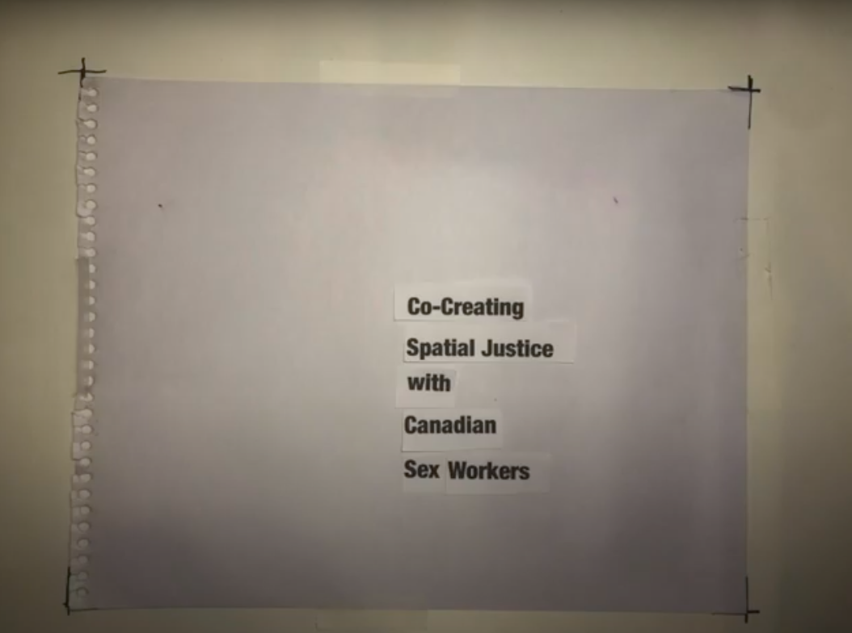
Alison’s Story
Co-Creating Spatial Justice With Canadian Sex Workers

Slide 11
The Process
https://www.youtube.com/watch?v=LVKeO5IIR_A

Slide 12
Step 1: Develop your Ideas
What do you hope to convey through your story?
What makes the story unique?
What ideas will have an impact on your audience?
What technologies can help convey this story?
What technologies can help you portray your story?

Slide 13
Step 2: Plan
Review your digital story ideas
Develop a plan for completing the story
Set goals for your planning process;
Establish timelines to develop your outline, find tools and resources;
Track your progress-- record your successes and challenges.

Slide 14
Step 3: Create the script
Create a detailed script for the story.
You will need a script of roughly 500-600 words to create a 4-5-minute video.
Your ‘voice’ is important. Ensure the language you choose effectively and evocatively conveys the meaning of your story.

Slide 15
Step 4: Storyboard
Storyboarding refers to a way of planning for all the things that will appear in the digital story
music, pictures, words, text, photos, and video.
Helps storytellers picture the entire story from start to finish.
Outlines the order of things and what will appear in the video.
Can inspire new ideas for organization or visual effects, show gaps, and improve the video’s quality.
Think about where you will be filming or recording. What are the challenges you may need to address (e.g., lighting, noise, background).
Can be as simple as sketching out your plans on paper or using computer technologies software programs or apps.

Slide 16
Step 5: Film and Record
Digital stories can have different visual and audio options, such as photos, video clips, text on the screen, voices, or a video of the storyteller.
These elements add interest to your story and direct attention to certain things.
Visual elements can include taking photos and videos, scanning old photos or drawings, and collecting images and materials from other locations.
Audio elements can include recording and editing voices and recording or finding music or sound effects.
Know what tools you need and the limits and abilities of your video tools.
Be aware of copyright rules: photos, music, or videos you’ve found on the internet may be protected by copyright. Whenever possible create your own.

Slide 17
Step 6: Edit and Finalize
During editing planning and recording come together to create a final product.
Ask yourself:
Is the purpose of your story clearly presented?
Does your story flow?
Does your story have impact?
Have you used images, rather than just words, to tell your story?
Are there any errors in text, auditory or visual components of your story?

Slide 18
Step 7: Publish and Share
Create a home for your digital story.
Video files are very large, often too large to share via email.
Use a personal website or blog, social media pages, or a video-specific hosting tool such as YouTube, Vimeo, or Wistia.

Slide 19
Caption this

Slide 20
“This is a brick wall and it’s the view outside of my bedroom window. It’s really symbolic to me…It is just like pushing through a lot of barriers - like going up against a brick wall.”
Fotheringham, S., Walsh, C. A., & Burrows, A. (2013). “A place to rest”: The role of transitional housing in ending homelessness for women. Gender, Place and Culture: A Journal of Feminist Geography, 21(7), 834-853. Doi: 10.1080/0966369X.2013.810605

Slide 21
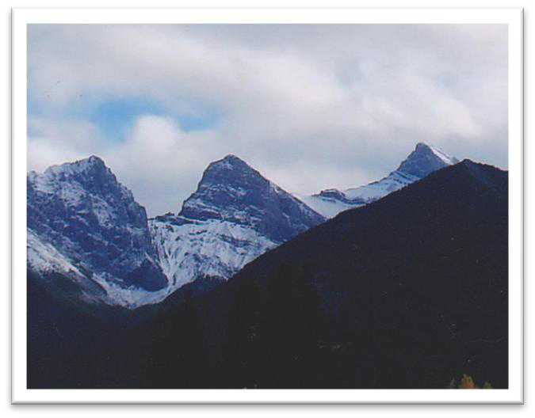
Caption this

Slide 22
The MSW program is my mountain. Its intimidation delayed me, yet now its beauty moves me towards it. I must balance the enjoyment with the climb, and soon I will reach the top.
Walsh, C. A., Casselman, P. J., Hickey, J., Lee, N., & Pliszka, H. (2015). Engaged in research/achieving balance: A case example of teaching research to masters of social work students. Contemporary Issues in Education Research, 8(2)

Slide 23
PART 2

Slide 24
Let’s get started
What story do you want to tell about your transformation, self, social work practice, education?
Select or take two images to help tell your story.
Write your 1-2-minute script (approximately 200 words).
Find a PowerPoint shell (or something else you are familiar with) and record your story.
Present your story.

Slide 25
Next steps
What worked?
What could be improved?
What do I need to do next?

Slide 26
Digital Story Premiere
Showcase a "reel" of Digital Stories created by social work students through workshops and mentorship with TFEL Co-Investigator, Dr. Christine Walsh.
The student creators will share their experiences and host a Q & A session.
Join us for transformative digital storytelling in action and learn more about the process.
Thursday July 14, 1:30-3:00 (MDT)
Friday July 15, 1:30-3:00 (MDT)
Emily Tetrault: My Journey as a Social Work Student
Marina Hirning: Working with Addiction and Mental Health
Clarissa Foss: COVID 19 School Closed
Karen Lok Yi Wong: My Story of Remote Practicum
Cindy Nguyen: Ơi — Living as an Asian in COVID 19
Andrea Rosenberger-Deleeuw: Using My Bundle to Navigate the Waves of Grief
Heather Shenton: A Mother's Grief, Helping my Daughter through Anorexia Nervosa
Heather Holdsworth: The Four Seasons of My Social Work Journey
Jennifer Flynn: Seasons of Change

Slide 27
References
Burgess, J. E. (2006). Hearing ordi nary voices: Cultural studies, vernacular creativity and digital storytelling. Continuum: Journal of Media and Cultural Studies, 20(2), 201-214. http://dx.doi.org/10.1080/10304310600641737
Chan, C. S., & Treacy, M. J. (1996). Resistance in multicultural courses: Student, faculty, and classroom dynamics. American Behavioral Scientist, 40(2), 212-221. http://dx.doi.org/10.1177/0002764296040002012
Chitat Chan & Melanie Sage (2019). A narrative review of digital storytelling for social work practice. Journal of Social Work Practice, DOI: 10.1080/02650533.2019.1692804
Goldingay, S., Epstein, S. & Taylor, D (2018). Simulating social work practice online with digital storytelling: Challenges and opportunities. Social Work Education, 37(6), 790-803,DOI: 10.1080/02615479.2018.1481203
Lenette, C., Cox, L., & Brough, M. (2015). Digital storytelling as a social work tool: Learning from ethnographic research with women from refugee backgrounds, The British Journal of Social Work, 45(3), 988-1005, https://doi.org/10.1093/bjsw/bct184
Moreau, K. A., Eady, K., Sikora, L., & Horsley, T. (2018). Digital storytelling in health professions education: A systematic review. BMC Medical Education, 18(1), 208. https://doi.org/10.1186/s12909-018-1320-1
Notley, T., & Tacchi, J. (2005). Online youth networks: Researching the experiences of ‘peripheral’ young people in using new media tools for creative participation and representation, 3C Media. Journal of Community, Citizen’s and Third Sector Media, 1, 73-81.
Skuse, A., Fildes, J., Tacchi, J., Martin, K., & Baulch, E. (2007). Poverty and digital inclusion: Preliminary findings of finding a voice project. New Delhi, India: The United Nations Educational Scientific and Cultural Organization (UNESCO). Retrieved from http://www.portal.unesco.org/ci/en/files/25679/11970268041poverty_en.pdf/poverty_en.pdf
University of Houston. (n.d.).The educational uses of digital storytelling. Retrieved from http://digitalstorytelling.coe.uh.edu/index.html
Vermont Teachers Teaching with Technology. (n.d.). Retrieved from http://www.uvm.edu/pt3/vt3/
Walsh, C. A., Shier, M. L., Sitter, K. C., & Sieppert, J. D. (2010). Applied Methods of Teaching about Oppression and Diversity to Graduate Social Work Students: A Case Example of Digital Stories. The Canadian Journal for the Scholarship of Teaching and Learning, 1(2). http://dx.doi.org/10.5206/cjsotl-rcacea.2010.2.3
Walsh, C. A., Rutherford, G., & Kuzmak, N. (2010). Engaging women who are homeless in community-based research using emerging qualitative data collection techniques. International Journal of Multiple Research Approaches, 4, 192–205.

Slide 28
For More Information Please Contact
Christine Walsh, cwalsh@ucalgary.ca
Natalie St-Denis nstdeni@ucalgary.ca
Alison Grittner alison.grittner@ucalgary.ca

Slide 29
Current Activities
Interviews on Promising and Wise Practices
Recruiting field directors/coordinators, faculty, field instructors, and other field stakeholders for a 30-60 min. interview
Impact of COVID-19 on Field Education
Recruiting BSW and MSW social work students to complete an online survey
Dialogue Circles
Recruiting BSW, MSW, and PhD social work students
State of Social Work Field Education
Recently closed a National survey with field directors/coordinators across Canada
Virtual Practicum Resources
Supporting BSW and MSW practicum students with opportunities to develop resources
Digital Story Guidebook
Developing a resource to support digital storytelling in field seminars
Field Image Showcase
Inviting BSW, MSW, and PhD students to submit an image and a narrative
Applied Practice Research Module
Developing an online training module to facilitate practice research in field education
Contact tfelresearch@gmail.com to participate!
Contact tfelproject@gmail.com to join!

Slide 30
For more information
about the partnership please contact:
tfelproject@gmail.com
Dr. Julie Drolet
Project Director
jdrolet@ucalgary.ca

