Slide 1
UNITY: Bringing Service Users and Students Together
Dr. Sandra Engstrom and UNITY members
Sandra.engstrom@stir.ac.uk
@sengstro

Slide 2
Who is UNITY?
Service user and carer involvement integral to Social Work programmes
The UNITY group was established in 2005
Regular meetings scheduled for the full year
A welcoming, inclusive environment where everyone’s views are encouraged
Catering is provided – symbolic message of welcome and appreciation
Everyone should feel they are getting something out of it
Adoption of co-production principles: Reciprocity, Equality, Accessibility & Diversity (SCOE, 2013)

Slide 3
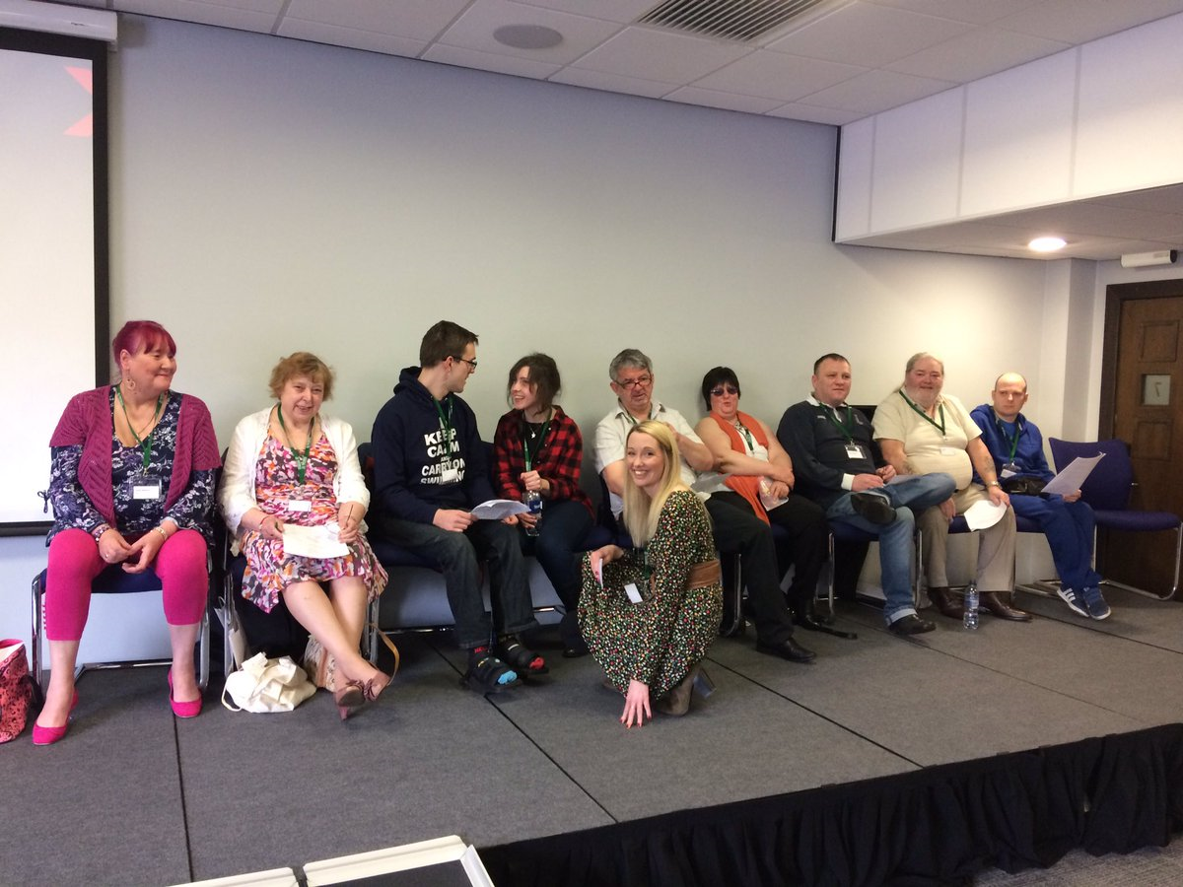
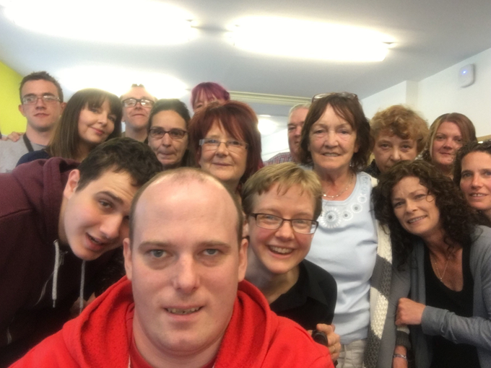

Slide 4
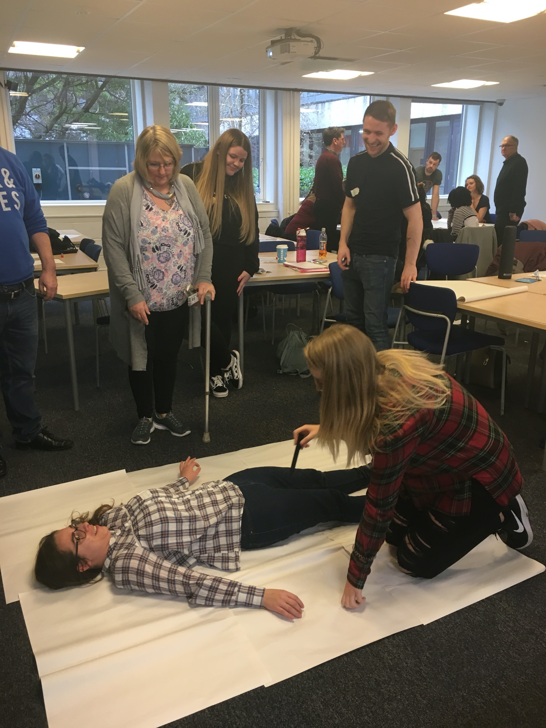
Workshops and other Involvement
Orientation Days
Induction- Ideal Social Worker
Being on the receiving end of services
Interview skills
Experiences of mental ill health
Experiences of different abilities
Law & Policy in Practice
Mental Health workshops with Nursing students
University of Calgary student workshops on ethics & values
Selection scenario consultation
Founder members of the Scottish Inter-University Service User and Carer Network
Stakeholder meetings
Programme Revalidation
Graduation

Slide 5
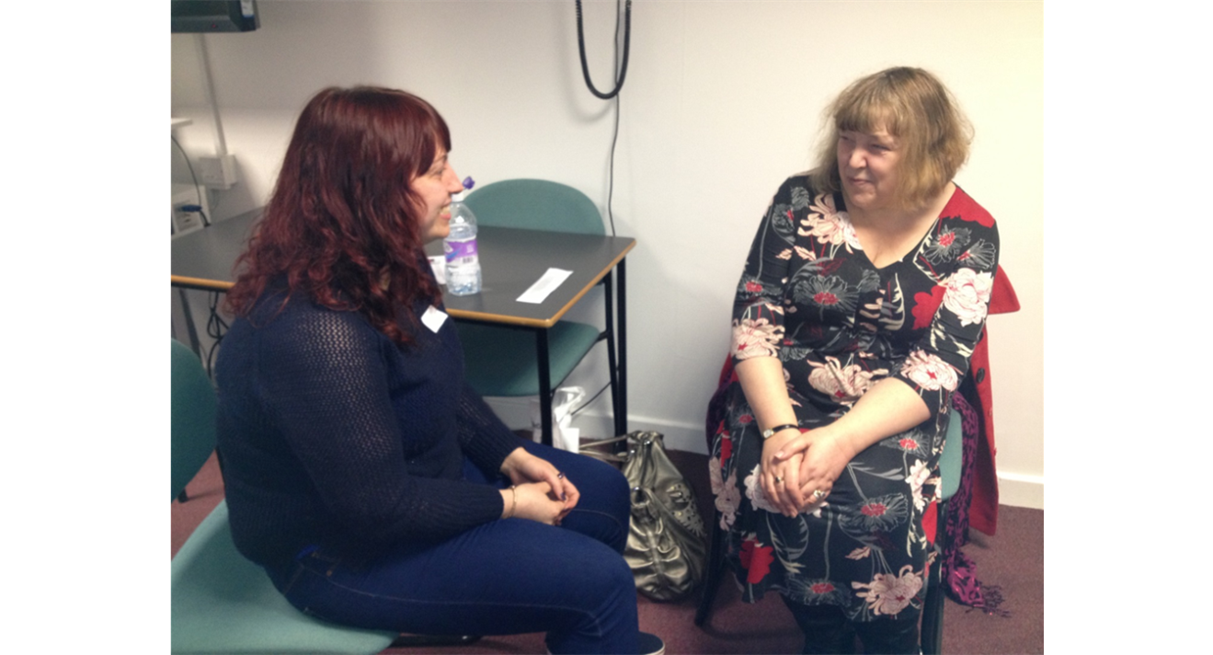
Interview skills workshop
Skills development before students undertake practice placement.
Scenarios based on Unity members’ real life experiences.
Students work in triads (one interviewing, two observing). Rotate around different Unity members.

Slide 6
What unity is to me, by Linda McCullloch.
Confidence
Friendship
Support
Respect

Slide 7
What do the students and faculty say?
Padlet

Slide 8
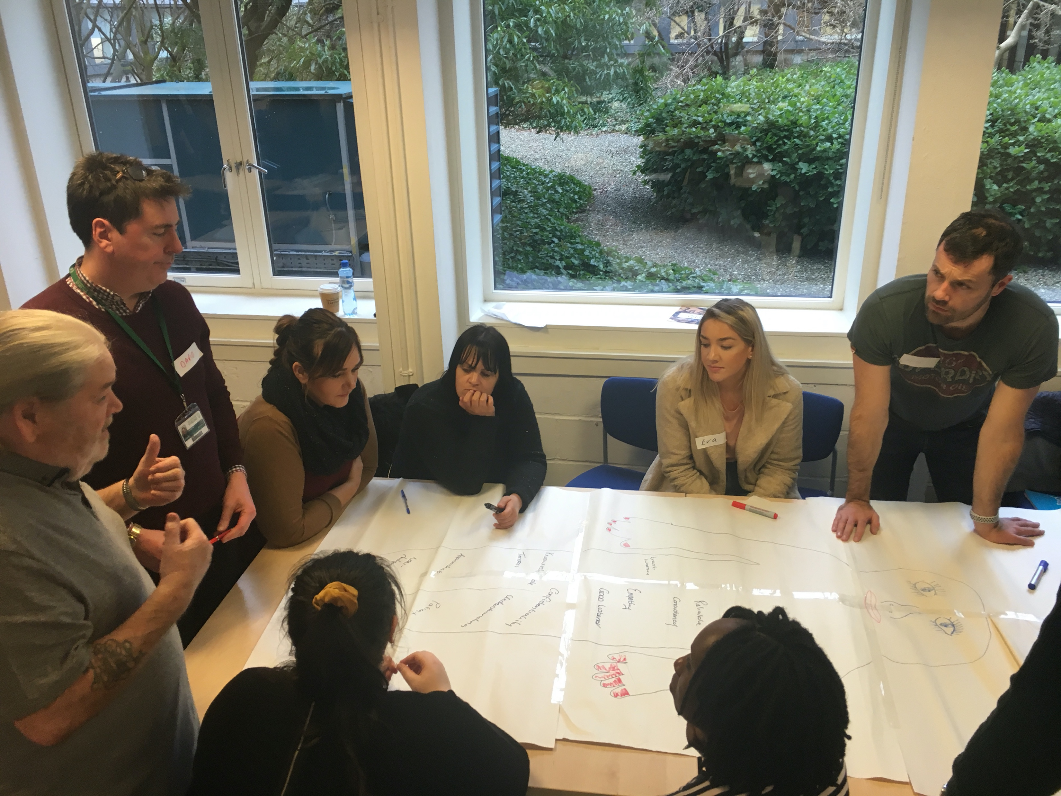
A few barriers
Can be reliant on support workers
Diversity
Access
Finances

Slide 9
Thank you! Questions?
Dr Sandra Engstrom and UNITY
Sandra.engstrom@stir.ac.uk

