Slide 1
Innovative, Promising, & Wise Practices: Social Work Field Education in the Prairie Region
Presenters: Dr. Vibha Kaushik & Shannon Klassen
Discussants: Dr. Christine A. Walsh
March 18, 2022
Notes:
VIBHA

Slide 2
Territorial Acknowledgement
The University of Calgary respectfully acknowledges the traditional territories of the people of the Treaty 7 region in Southern Alberta, which includes the Blackfoot Confederacy (comprising the Siksika, Piikani, and Kainai First Nations), as well as the Tsuut’ina First Nation, and the Stoney Nakoda (including the Chiniki, Bearspaw, and Wesley First Nations). The City of Calgary is also home to Métis Nation of Alberta, Region III.
ii’ taa’poh’to’p
University of Calgary Office of Indigenous Engagement

Slide 3
The Transforming the Field Education Landscape (TFEL) project is funded in part by the Social Sciences and Humanities Research Council of Canada.
Partnership Grant: Talent (2019-2024)
Notes:
JULIE

Slide 4
Outline
Project overview
Background and context
Purpose of the study
Key terms
Data collection and analysis
Findings and key themes
Conclusion and implications
Moving forward
Discussion

Slide 5
Background & purpose

Slide 6
Project Overview
TFEL is a partnership project that aims to prepare the next generation of social workers in Canada by creating training and mentoring opportunities for students, developing and mobilizing promising and wise field education practices, and improving the integration of research and practice in field education (TFEL, 2020).

Slide 7
Background and context
In Canada, social work field education is in a state of crisis (Ayala et al., 2017; Bogo, 2015).
Resource scarcity, financial cutbacks, and increasing student enrollment negatively impacting social service agencies and educational institutions (Ayala et al., 2017; Macdonald, 2013).
COVID-19 has aggravated issues by limiting placement options, shifting social work to online delivery, lockdowns, and other disruptions education and services (Kourgiantakis et al., 2021).
Field education is no longer sustainable and in desperate need of restructuring to address the current challenges while continuing to provide students with high quality field education experiences (TFEL, 2020).
The crisis needs to be addressed before it negatively impacts the learning needs of students and the ability of the profession to deliver quality education and social services to local communities (TFEL, 2020).
Literature advocates for integration of indigenous practices within field education (Clark & Drolet, 2014).

Slide 8
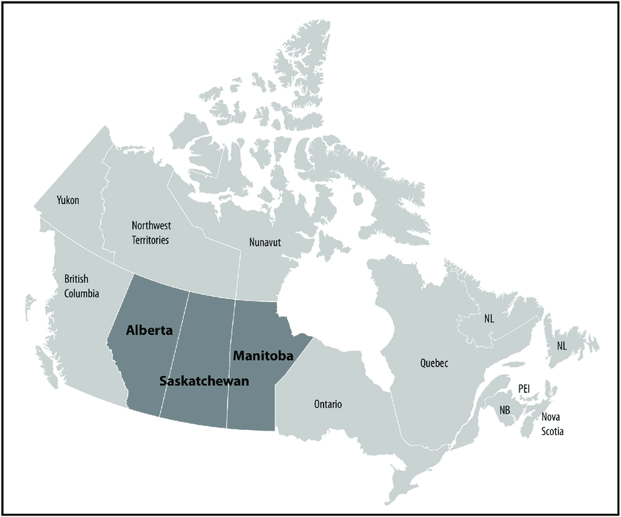
Purpose of the study
To identify innovative, promising, and wise practices that could assist in the development of sustainable models of field education in Canada.
Focus of the webinar:
To report and discuss the findings of the interviews conducted in the Prairie region – Alberta, Saskatchewan, and Manitoba.

Slide 9
Key Terms
Notes:
The key terms for this study include innovative, promising, and wise practices. We’ll go over definitions for these terms here.

Slide 10
Innovative practices
Cutting edge practices that have the potential to enhance field education while addressing existing challenges.
New practices that have not yet been tested in some areas.
Show promise in their potential to enhance field education and address some of the challenges that exist.

Slide 11
Promising Practices
Approaches, interventions, programs, services, or strategies that show potential for enhancing field education.
May address specific challenges experienced in social work field education.
May be undergoing evaluation for effectiveness and replicability and have demonstrated the ability to achieve their stated aims.

Slide 12
Wise Practices
Indigenous-centered practices that are flexible, locally, and culturally relevant.
Respect all forms of understanding including lived experience, traditional knowledge, and the use of story.
Relational in nature and encourage mutual respect, inclusivity, and collectivity.

Slide 13
methodology

Slide 14
Data Collection
Data collection
July – December 2020.
35 semi-structured interviews with field directors/ coordinators, faculty liaisons, field instructors, and field supervisors in Prairie region.
Purposive and snowball sampling.
Recruitment notice – TFEL newsletter, website, social media, and emails to TFEL members.
Online interviews via Zoom or Microsoft Teams.
20 open-ended questions.
$20 Gift Cards.

Slide 15
Data Analysis
Auto transcription using Zoom and Microsoft Teams.
Transcripts reviewed and edited by research assistants, coded for thematic analysis (Fonteyn et al., 2008; MacQueen &McLellan, 1998).
Team-based coding: Group and independent using Microsoft Word.
Master codebook: Code names, definitions, and relevant quote.
Codebook periodically reviewed.
NVivo 12.0 used in the final stage.

Slide 16
Findings
Notes:
Our findings included a total of 80 unique codes that pertained to innovative, promising, and wise practices, with an additional 57 codes that did not fit within these 3 themes for a total of 137 codes across the entire study.
In order to keep this webinar short, we will only be discussing codes related to innovative, promising and wise practices, with a sidenote around the Covid-19 pandemic.

Slide 17
What were the main innovative practice Themes?
Creativity
Flexibility
Technology
Macro-level Placements
Risk-Taking
Notes:
Innovative practices included 19 specific codes; the top innovative themes included creativity, flexibility, technology, macro-level placements, and risk-taking.
One participant shared their experiences around innovation: “You know, I've heard social work field educations that a crisis. And Uhm. I want to say that crisis could be an opportunity. And the opportunity that, I think I said this about midway through, are we prepared to let go of what we're holding on to so tightly as this sacred cow of field education? Are we OK? Let go of it and really let ourselves immerse in the unknown. And that means different models of field experience, we need different ways of how do we get those skills, that doesn't just rely on being in in a practicum in a formalized health setting. So that’s, and we need a, uh, faculty that’s on board, faculty members that are, I'm gonna say, still part of the field.”
We will discuss the top two themes in greater depth shortly, and briefly review creativity, macro-level placements, and risk-taking here.
Participants felt that creativity needs to play a larger role in field education, suggesting the implementation of less traditional ways of teaching and evaluation, as well as broadening the guidelines of what constitutes an acceptable practicum in order to offset the ongoing resource scarcity they frequently face.
Participants also indicated the need to focus on macro-level skills and placements rather than sticking to the more well-known territory that is micro-level placements. Suggestions they had were to include more research, policy and community development placements as well as expand practica options to include self-directed and project-based placement options.
Finally, participants felt that it was important for field education to not only think outside the box, but also begin taking more risks to support innovation and create a new version of field education that is more innovative and challenges the status quo.

Slide 18
Main Themes: Innovative Practices
Incorporating Technology
“Right now, we've actually seen things like Zoom [and] Microsoft Teams to be able to be the way that we connect right so? The students are really eager, and they're interested in that, and that's what we're here for is to help them achieve their learning goals.”
Increased
Flexibility
“There may be [some] possibilities only available over summer months or even certain times of the year, but it's very intense, so maybe some flexibility for some students to do that too. If the placement wants to have it.”
Notes:
The top two innovative practices mentioned by participants were incorporating technology and increased flexibility with in field education.
While the transition from in-person to virtual due to the Covid-19 pandemic was rocky for some participants, most indicated that it has helped enhance field education in some areas, that students were willing and able to embrace the use of technology within their placements, and that embracing a virtual environment has helped offset resource scarcity and in some cases led to cost-saving practices like online orientation and agency training. Overall, it was seen as a benefit to field education and one of the primary aspects that field educators would like to permanently utilize.
“Right now, we've actually seen things like Zoom [and] Microsoft Teams to be able to be the way that we connect right? So, the students are really eager, and they're interested in that, and that's what we're here for is to help them achieve their learning goals.”
Practitioners also indicated the need for increased flexibility within field education in order to meet the needs of diverse groups of students, acknowledging that students have various commitments and life circumstances and that a one-size-fits-all model of field education is not sustainable and often creates barriers to success. Ideas for increased flexibility included placements options at different times of the year, self-directed practica, increased rural placement options, and integrating technology so students are able to work from home if necessary, creating a more accessible, student-oriented model of field education.
“There may be [some] possibilities only available over summer months or even certain times of the year, but it's very intense, so maybe some flexibility for some students to do that too. If the placement wants to have it.”

Slide 19
What were the Main Promising practice Themes?
Collaboration with Community
Non-Traditional Placement Options
Atypical Supervision Strategies
Open-Mindedness
Group Processing Strategies
Notes:
Promising practices included 49 distinct codes, by far the most of any subtopic in the study.
One participant shared their thoughts on promising practices: “it's more of an approach that speaks to that rationality between the person who is representing the institution, the person who is representing the education, and the student in between. So, in that directionality, we all bring different experience. If it was of expertise, we share the same objective, to help our students to learn and succeed and also challenge them to understand what social work in practice is all about. To me, that would be to promising approach.”
The top 5 themes included non-traditional placement options, atypical supervision strategies, collaboration with community, open-mindedness, and group processing strategies. Once again, the top two will be discussed in greater detail momentarily, here we’ll focus on discussing the others.
Participants felt that collaborating with community agencies was integral to field education, and that when universities help tailor field placement options to the needs of individual communities and agencies, all parties benefit.
Around open-mindedness, they also felt that students needed to be oriented to the realities of field, and encouraged to keep an open-mind regarding placements, organizations, and populations they are interested in working with.
Lastly, participants found that the use of group processing strategies enhanced field education through the provision of training. while requiring less resources than individual supervision while simultaneously providing peer support and encouraging mutual learning for students.

Slide 20
Main Themes: Promising Practices
Non-Traditional Placement Options
“I think in terms of thinking outside the box or being creative and innovative in our field practicums there are opportunities to do more work with those agencies - in non-traditional social work agencies - where maybe they don't have on the ground social work supervision, but they are amazing opportunities for our students.”
Supervision Strategies
“We need to also expand our understandings of supervision and, what supervision looks like to include online e-supervision, group supervision.”
Notes:
The top two promising practices indicated by participants were non-traditional placement options and utilizing unique supervision strategies.
Participants showed interest in engaging atypical strategies such as self-directed, project-based, and virtual-based placements, as well as collaborating with agencies to create placements that may not be considered traditionally social work oriented, but have needs social workers could fill, and finally, creating relationships with agencies that don’t have registered social workers available for supervision, but are still able to provide students with adequate learning and experience. Participants also suggested reimagining field education with the student at the centre, and being open to creating placements around individual student needs for a more learner-focused experience.
“I think in terms of thinking outside the box or being creative and innovative in our field practicums there are opportunities to do more work with those agencies - in non-traditional social work agencies - where maybe they don't have on the ground social work supervision, but they are amazing opportunities for our students.”
Similarly, participants suggested reconceptualizing how field education views supervision as a way to offset increasing resource scarcity and enhance student growth, learning, and development. Many participants felt that the current definition of supervision is too narrow and causes additional stress on both the field education system as well as agencies and students. Some suggestions included online supervision, group supervision, sharing supervision among multiple agency staff, and utilizing other students or recent alumni as supervisors for current students.
“We need to also expand our understandings of supervision and what supervision looks like to include online e-supervision, group supervision.”

Slide 21
What were the main Wise practice Themes?
Incorporating Indigenous Practices
Engaging Elders
Redefining Social Work Practice
Restructuring Learning Agreements
Perspective-Taking
Notes:
A total of 12 unique codes were found for wise practices, with the top 5 themes including incorporating indigenous practices, redefining social work practice, engaging elders, restructuring learning agreements, and perspective-taking.
One participant shared with us their thoughts on wise practices: “So I think for social work to continue to evolve, adoption of wise practices is now considered normative. You know, it's important because without that you will lose the depth of relationships. I think you won't get the context pieces very well, and as a practice, I think there's a lot of wisdom, I think you know, in different cultures. Which is how they did charity and they helped other people, like they just didn't call it social work in that way. Um, so I think you know education can gain a lot from adopting some of these wise practices that may come from other groups, communities and contexts.”
As you may have already guessed, we’ll look at the top two wise practices in-depth in a moment and focus on the remainder here.
Engaging elders was defined as being intentional when engaging with Indigenous Elders regarding field education. Some suggestions included consulting with Elders to develop strategies for decolonizing field education from the bottom-up, as well as bringing in elders to seminars and supervision to ensure that Indigenous knowledge is integrated into learning.
It was also suggested that restructuring learning agreements in a way that takes into account unique field placements, as well as the cultural backgrounds of students and supervisors rather than requiring the typically strict, form-based learning agreement would be a wise addition to field education.
Finally, participants felt that perspective-taking needed to be incorporated into field education in ways that support students to take on the perspectives of others, develop self-awareness and understand the current and historical effects of colonization on how things are done in the social work realm.

Slide 22
Main Themes: Wise Practices
Incorporating Indigenous Practices
“The wise practices and looking at Indigenous ways and other ways of knowing, I think that there's areas that were not currently practicing, areas where we don't currently have placements and those are the areas that I see opportunities for us to look at what a student wants to learn and what their gifts are and their skills are, and how can we match this with what communities need.”
Redefining Clinical Practice
“We've also looked at being really creative, flexible and open minded about definitions of certain terms, such as like “clinical practice,” when we know […] that's a very westernized notion, and that it might not be an appropriate one to apply in all contexts. And so, I think our main innovation around that has been trying to work with students who find our traditional way of doing things problematic. I think we would like to be able to do more in this way and to expand these notions and maybe sort of generalize this approach more.”
Notes:
The top two wise practices that were indicated by participants were incorporating indigenous practices, and redefining clinical practice.
Participants suggested that students should be exposed to and partake in, Indigenous cultural practices in a culturally sensitive, non-appropriating way, throughout their learning in an effort to provide students with the understanding of how western knowledge and learning are not the only ways of doing things, and how shifting one’s mindset around what constitutes learning can create more open-minded, self-aware, culturally competent social workers.
“The wise practices and looking at Indigenous ways and other ways of knowing, I think that there's areas that we’re not currently practicing, areas where we don't currently have placements, and those are the areas that I see opportunities for us to look at what a student wants to learn and what their gifts are and their skills are, and how can we match this with what communities need.”
Participants also felt that the current definition of clinical practice has been westernized and must check specific boxes with little room for flexibility or the incorporation of other cultures and ways of knowing. Participants indicated that a wider definition would provide the basis for challenging western assumptions, and providing ways of including other cultural practices and other more flexible ways of looking at and problem solving the current social issues faced by society.
“We've also looked at being really creative, flexible, and open minded about definitions of certain terms such as like “clinical practice,” when we know -- that's a very westernized notion, and that it might not be an appropriate one to apply in all contexts. And so, I think our main innovation around that has been trying to work with students who find our traditional way of doing things problematic. I think we would like to be able to do more in this way and to expand these notions and maybe sort of generalize this approach more.”

Slide 23
Main Themes: Covid-19
Effects on Field Education
“So, there's been a lot of missed time. And you know, students will read policy manuals only so much and the challenges is, you know, even if you were, if there was no COVID you would still attend to the policy and practice manuals, and especially I could see how [inaudible] agencies. But you would be having discussions. You have a connection with somebody and now they’re doing it at home. There’s pieces missing. You’ve read it, but where does it go? How do you integrate that? That's why I always my fear.”
Opportunities Provided
“I think the current context is a challenging one. I think it was challenging before COVID. I think it's been made even more challenging since COVID. I think as a social worker now working remotely. That can be a challenge. But I also think it presents a new opportunity to kind of rethink why we're doing things. I think in moving in online spaces and supporting virtual practicums, it's an opportunity to think about what are the online skills that students also need to develop.”
Notes:
We would also like to include the emergence of the Covid-19 pandemic as a way to provide additional context for our findings in this study.
The Covid-19 pandemic has had far-reaching and often ongoing effects on the state of social work field education. Many participants discussed the additional stresses of restructuring how field education was done while in the midst of a global health emergency, and how the already increasing resource scarcity was escalated to, at the time, unseen proportions. They discussed the increased pressure within their agencies and the added stress of ending practicums mid-semester, while simultaneously contending with increased demands, decreased placement options, and the need to learn how to navigate the social work world virtually while still providing standards of care to clients.
“So, there's been a lot of missed time. And you know, students will read policy manuals only so much and the challenges is, you know, even if you were, if there was no COVID you would still attend to the policy and practice manuals, and especially I could see how ... But you would be having discussions. You have a connection with somebody and now they’re doing it at home. There’s pieces missing. You’ve read it, but where does it go? How do you integrate that? That's why I always my fear.”
Conversely, many participants felt that the Covid-19 pandemic provided the field education system with the motivation it needed to become more innovative, flexible, and accommodating to the various needs and demands of students. Many felt that the capacity to work remotely is something that should be carried forward into the future where possible, and that remote work specifically opens up numerous avenues for placement options that were previously viewed as impossible or less viable.
“I think the current context is a challenging one. I think it was challenging before COVID. I think it's been made even more challenging since COVID. I think as a social worker now working remotely, that can be a challenge. But I also think it presents a new opportunity to kind of rethink why we're doing things. I think in moving in online spaces and supporting virtual practicums, it's an opportunity to think about what are the online skills that students also need to develop.”

Slide 24
Conclusion
Notes:
As you’ve seen, this study has provided researchers and field educators with much food for thought regarding the transformation of social work field education. We now conclude with the implications for field education practice and our recommendations for moving forward.

Slide 25
Implications
Urgent need for reevaluation of social work field education programs – conceptualization, structure, and delivery.
Need for innovation in social work field education for preparing the next generation of social workers.
New practices, insights and approaches to teaching and learning will allow social work education to evolve and thrive in increasingly demanding social, educational, and labor market contexts.
Notes:
As we’ve seen, there is an urgent need to transform the social work field education programs, encourage creativity and innovation, provide more flexible options within the field, and find ways to decolonize the current system. Through the generous participation of field educators across the prairie provinces, we have been given a multitude of new practices, insights and approaches that will form the basis for the transformation of social work field education and hopefully create lasting change that benefits social workers, educators, students and clients for years to come.

Slide 26
Data Collection
Moving Forward: FOCUS GROUP ON TRANSFORMING FIELD EDUCATION
Ongoing
Actively recruiting in Atlantic, BC, Manitoba, Quebec, and Saskatchewan regions
Goal: 120 participants
Current status: 20 focus groups with 69 participants
Notes:
As one way of moving forward, ongoing focus groups are being conducted looking at how to best transform social work field education with the goal of speaking to 120 field educators nationally. At present, we are more than halfway to our goal, with more focus groups being scheduled weekly.
Our focus group team did connect yesterday and are able to provide an update to these numbers:
A total of 20 focus groups have been conducted across Canada, with 81 field educators participating, with the majority of participants located in Alberta and Ontario
3 more focus groups are scheduled for the next week, including one this afternoon.
A total of 16 additional participants are currently in contact with our focus group team and in the process of being scheduled.
We have roughly 5 transcripts coded and are hoping to have all coding completed early in April with the aim of having a report detailing our findings by the end of May.
In addition to FGs, the TFEL team is currently in the process of compiling an inventory of National innovative, promising, and wise practices. Our vision is to develop a user-friendly practical resource that would list and describe practices that have been identified in the interview data. The inventory will be divided into thematic areas representing innovative, promising, and wise practices. The work is currently in progress. Once completed, the inventory will be available on the TFEL project website.

Slide 27
Moving Forward
Notes:
Our recommendations for social work field education in light of the findings in this study include:
Encouraging discussion within schools of social work on how to improve the current field education system in a courageous, hands-on manner that is specific to local and cultural needs, but also takes into account what is currently possible within each environment.
Encouraging field educators within agencies to continue to voice their concerns with field coordinators and field liaisons, in hopes that the squeaky wheel does indeed get the grease.
And
Encouraging field education policy-makers to take note of the struggles and recommendations made by field educators within this study.
Ultimately, we hope this research provides a resource for creative, innovative, and sustainable options on how to restructure and transform social work field education in a way that reduces the stress on the current field education system, engages conversations among stakeholders, and provides benefits to students, field educators, and clients.

Slide 28
DISCUSSION

Slide 29
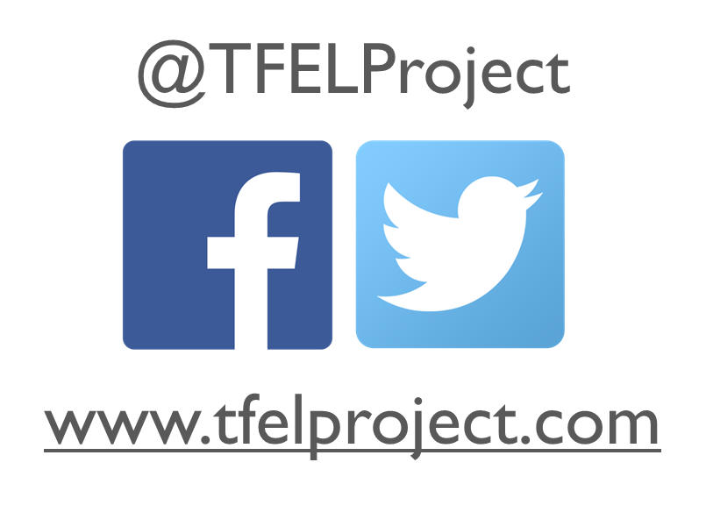
For more information
about the partnership please contact:
tfelproject@ucalgary.ca
Dr. Julie Drolet
Project Director
jdrolet@ucalgary.ca
Notes:
VIBHA?
Thank everyone for joining and communicate contact information

Slide 30
References
Ayala, J., Drolet, J., Fulton, A., Hewson, J., Letkemann, L., Baynton, M., Elliott, G., Judge-Stasiak, A., Blaug, C., Gerard Tetreault, A., & Schweizer, E. (2017). Field education in crisis: Experiences of field education coordinators in Canada. Social Work Education, 37(3), 281-293.
Bogo, M. (2015). Field education for clinical social work practice: best practices and contemporary challenges. Clinical Social Work Journal, 43(3), 317-324.
Clark, N., & Drolet, J. (2014). “Melq'ilwiye” coming together: Reflections on the journey towards Indigenous social work field education. Currents: Scholarship in the Human Services, 13(1), 1- 21.
Fonteyn, M. E., Vettese, M., Lancaster, D. R., & Bauer-Wu, S. (2008). Developing a codebook to guide content analysis of expressive writing transcripts. Applied Nursing Research, 21(3), 165-168. DOI: 10.1016/j.apnr.2006.08.005
Kourgiantakis, T., Hu, R., Ramsundarsingh, S., Lung, Y., & West, K. J. (2021). Teaching note-virtual practice Fridays: Responding to disruptions caused by the covid-19 pandemic in the field and classroom. Journal of Social Work Education, 57(1), 111-119. https://doi.org/10.1080/10437797.2021.1932651
Macdonald, L. (2013). Making the invisible visible: A workload study on the role of field education coordinators in Canada. Canadian Social Work, 15(1), 60-73.
MacQueen, K. M., McLellan, E., Kay, K., & Milstein, B. (1998). Codebook development for team-based qualitative analysis. Cultural Anthropology Methods Journal, 10(2), 31-36. DOI: 10.1177/1525822X980100020301
TFEL Project. (2020, May 20). Transforming the field of education landscape. TFEL Project. https://tfelproject.com/.

